Slide 1

Brief
This is my week 8 solo project on the QA training course. It involved setting up a fullstack application, with a database to store data, an API and a frontend in HTML.

Slide 2
Tools
Throughout this project, I used:
Eclipse as my Java IDE
Junit for testing
Maven for dependencies and build management
Github for repository management
Draw.io and PlantUML for UML and ERD creation
Atlassian Jira and Confluence for my project planning and visualisation

Slide 3
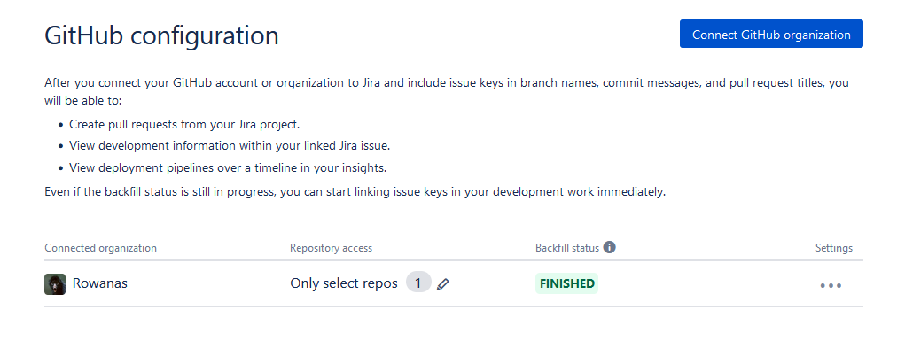
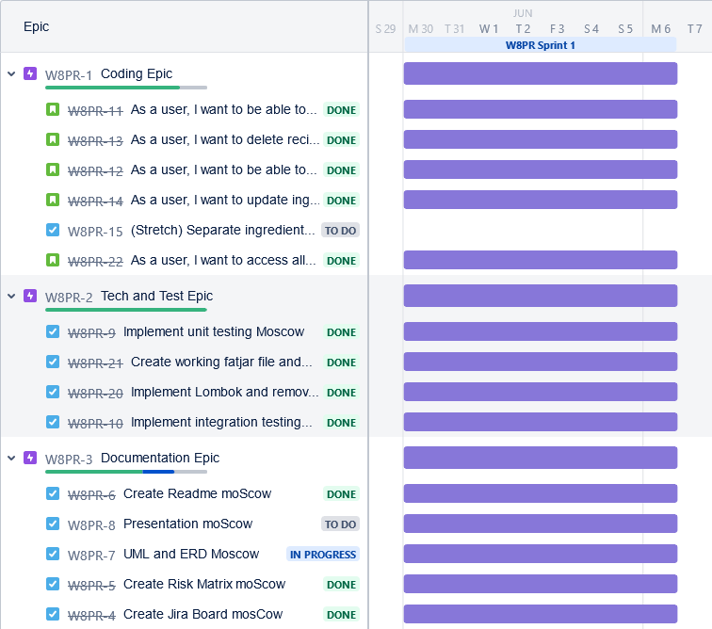
Jira Setup
I set up Jira with Github integration which is a suggested and largely built-in function of Jira, requiring only a confirmation within Github. Form then on, I was able to link branches and commits to the appropriate stories and epics by using the W8PR code, as seen below.
https://rowanatwork.atlassian.net/jira/software/projects/W8PR/boards/2

Slide 4
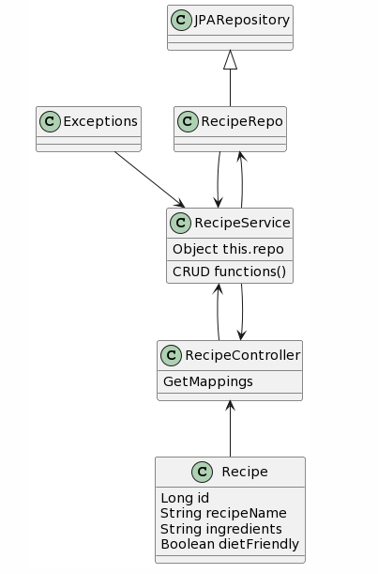
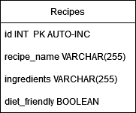
Initial Planning
Learning from my last project, I made a much clearer UML. It’s still relatively bare, but I understood better how to create my code. My ERD is a single table.

Slide 5
Prioritisation
To help me prioritise my tasks and choose which tasks should be additional goals, I used the MOSCOW method. In my Jira, I named my user stories and tasks with moscow, capitalising M for must have, for instance. This provided me with an instant and obvious categorisation.

Slide 6
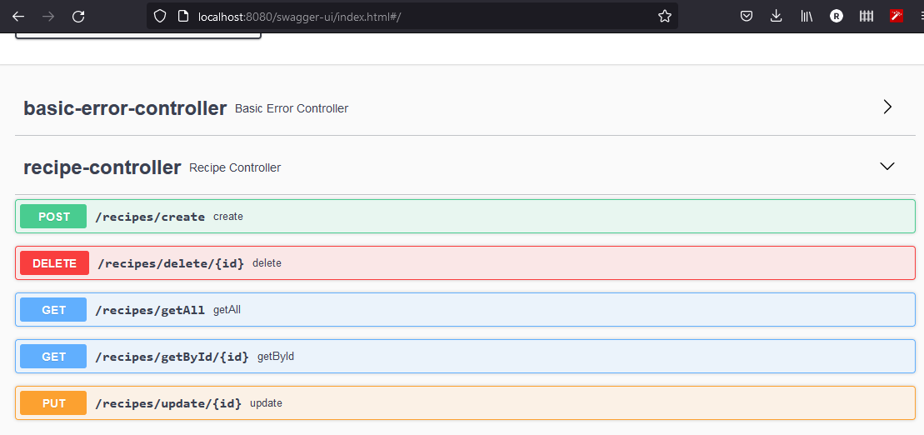
Proposed Implementation
My initial proposed implementation was to have an API in Java, supported by JavaScript logic which turned my 4 basic CRUD commands into more interesting functionality to be displayed via HTML with CSS styling. On the backend, my Java API would like to a Java Service and then on to a repository.

Slide 7
Project Summary
In the end, my project is much the same. Proper planning initially resulted in less deviation from my proposal. I learnt a great deal along the way, mostly in code. The linear way I did my commits means that my github commit view is a straight line.

